Slide 1
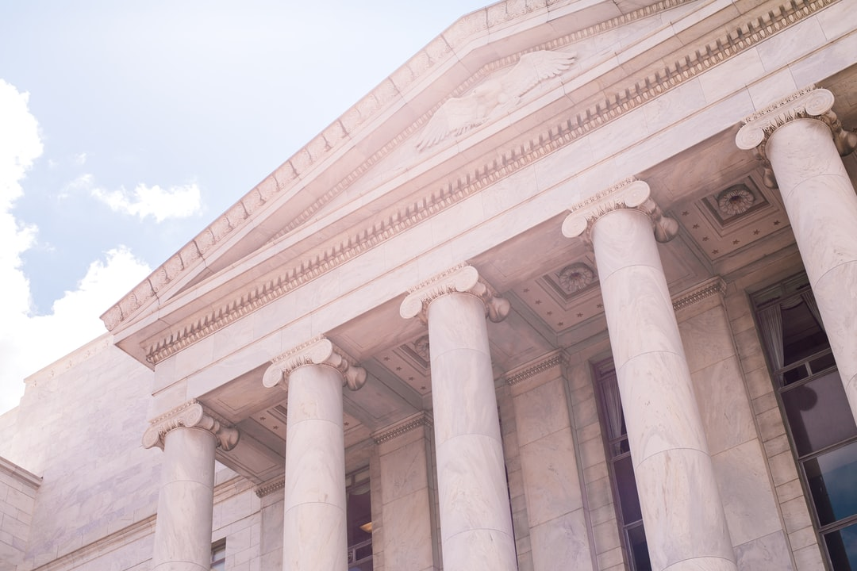

1O SERVICES PROVIDED BY THE GOVERNMENT
A guide to benefits provided by the municipal, provincial, and federal government

Slide 2
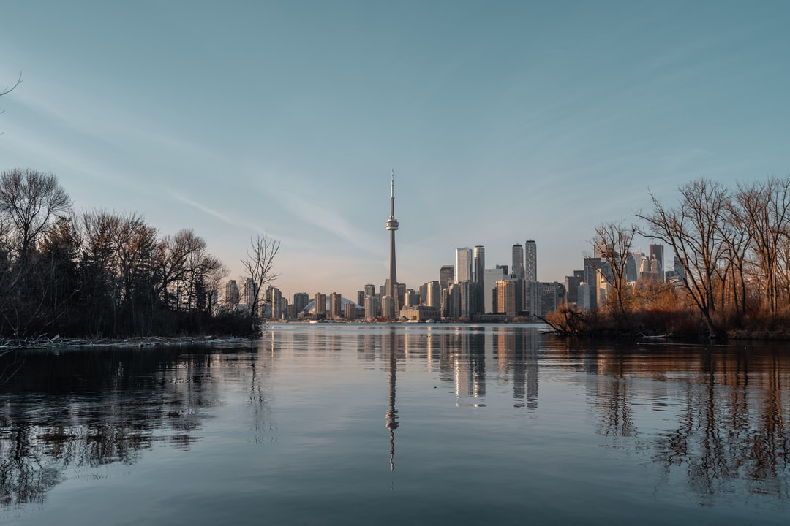
Health care
Canada’s provinces and territories have access to Medicare, which is publicly funded healthcare. Every province has their own plan. For instance, Ontario runs OHIP, Ontario Health Insurance Plan. OHIP covers visits to the doctor, hospital stays, ambulance services, and other eligible services like optometry or dental surgery. To be eligible to OHIP coverage, you must be an eligible resident of Ontario. Other services that are not covered are paid by the patient and are not covered by the Provincial Government.

Slide 3
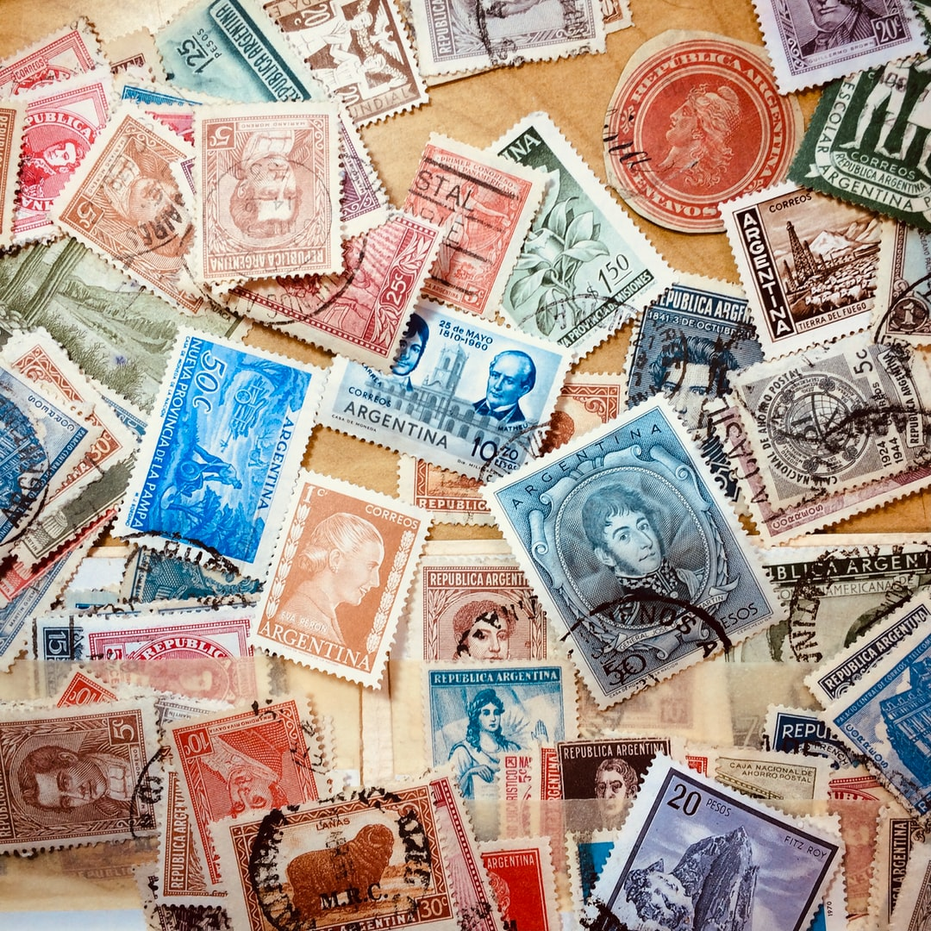
Postal Service
Canada Post is run by the Federal Government from taxes and money earned from the business. They offer a range of service from personal to business. They offer international shipping on mail and parcels. To ship 5 sheets of paper to the US, it costs $1.27, and to ship the same thing internationally, it costs $2.65. Canada Post also sells an array of stamps, collectables, and other mail-related goods.

Slide 4
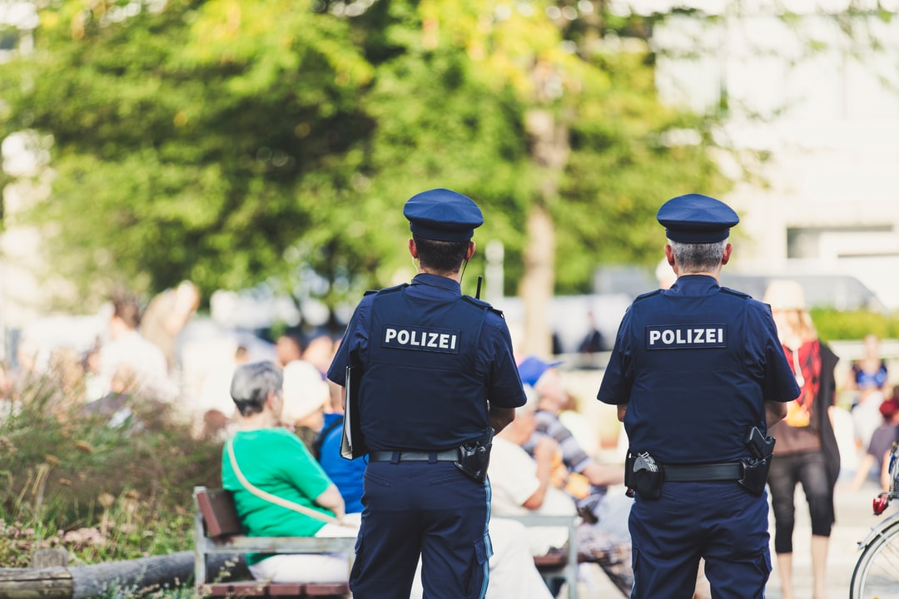
Law Enforcement
Law Enforcement is taken care of mostly at the Municipal level, though there is crossover from other levels of government as well (eg. OPP). Each town or city has their own police service, which may vary. The Toronto Police Service takes alarm calls, which come as emergencies. The overwhelming majority of these calls are false, meaning no emergency was taking place. TPS has about 5400 officers and 2500 other employees.

Slide 5

Water
Water management includes wastewater and utility water. Water is managed at a municipal level. In Toronto, water is managed by Toronto Water, consisting of six business sections. Toronto water manages storm drains, wastewater collection and treatment, and supply of drinking water. Sewers, hydrants and basins have to be maintained and built on a daily basis. The City of Toronto utilizes four treatment plants located around the city, and utilizes storage tanks and distribution pumps. Officially, Toronto Water is under the Toronto Water Division.

Slide 6

Waste Collection
Waste is divided into 3 sections, recycling, compost and garbage. The Solid Waste Management Services cover these 3 sections across all of Toronto. In addition to there three, Toronto also collects yard waste, electronic waste, metal items, and oversized waste. They cover over 900,000 homes and businesses, 10 000 park bins, 9 335 street litter/recycling bins, and more. After collecting garbage, it is disposed into landfills.

Slide 7
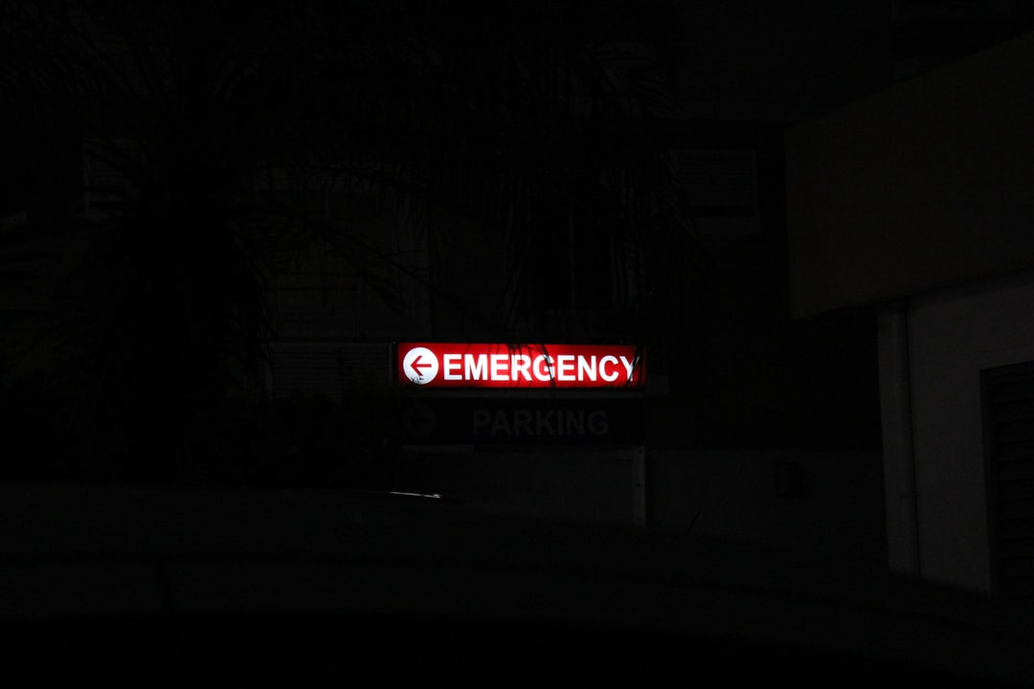
Fire and Emergency
Toronto Fire Services is responsible for protection against loss of life, property, and the environment from fires, accidents and other hazards. They inform the community about potential disasters. Fire regulations and alarms, carbon monoxide alarms, and home inspection are vital to a safe house. In addition to household, schools and public buildings are also covered. They are the largest fire service in Canada.

Slide 8

Education
Education funding is provided by the provincial government. The Ministry of Education support a variety of programs, ranging from early daycare to grade 12. Education is publicly funded from JK to grade 12. The ministry is in charge of the curriculum, and regulations/rules. An example of this is EQAO, a standardized test which grades Ontario students on a range of core subjects. They oversee the various school boards found in the cities and towns of Ontario.

Slide 9

Transportation
The TTC, Toronto Transit Commission, is a public transportation service provided by the City of Toronto. Beginning operation in 1921, the TTC is the most used mass transit system in Canada, and the third in North America. The TTC charges money for single use tickets, and also offers monthly passes. The newly implemented Presto system is making transactions happen online, and aims to remove the need of tokens and tickets.

Slide 10
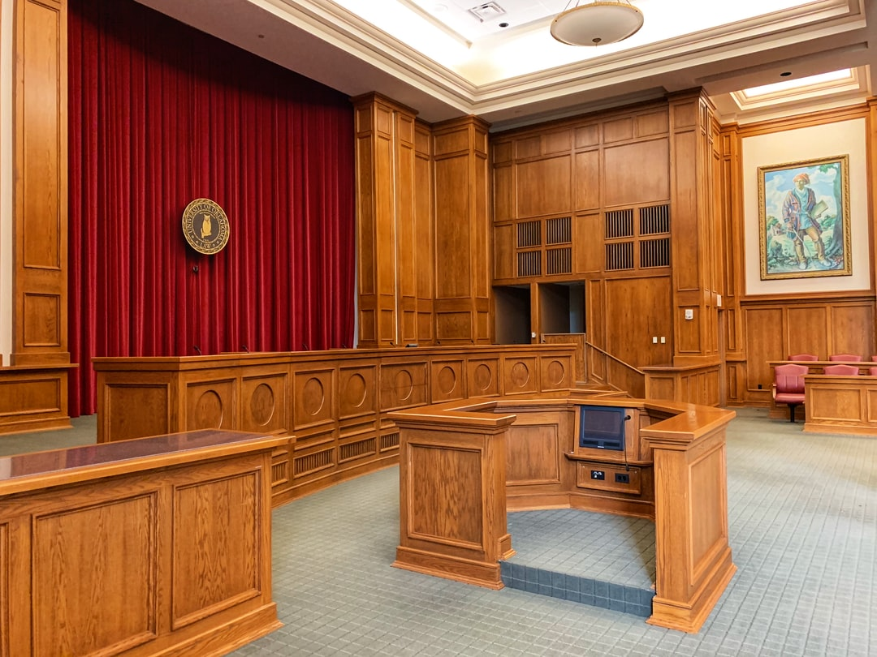
Federal Court
Court is represented on all 3 levels of Canada’s government, but for this section we focus on federal court. The Chief Justice, Richard Wagner, has a variety of unique roles to fill. The Supreme Court of Canada is the highest level of court, and is considered the final say of a case. The decision of the Supreme Court cannot be overturned. The court embraces the law of every province and territory, and aims for the fairest verdict possible.

Slide 11

Urban Planning
Planning and development of a city is the municipal government’s responsibility. Toronto’s city plans conform to green standards and other regulations to ensure the city has a high standard of living. The planning and development sector are responsible for housing, roads, parks, telecommunication towers, and more. Though this job isn’t limited to the government, regulation and guidelines created by the government must be followed by private companies.

Slide 12
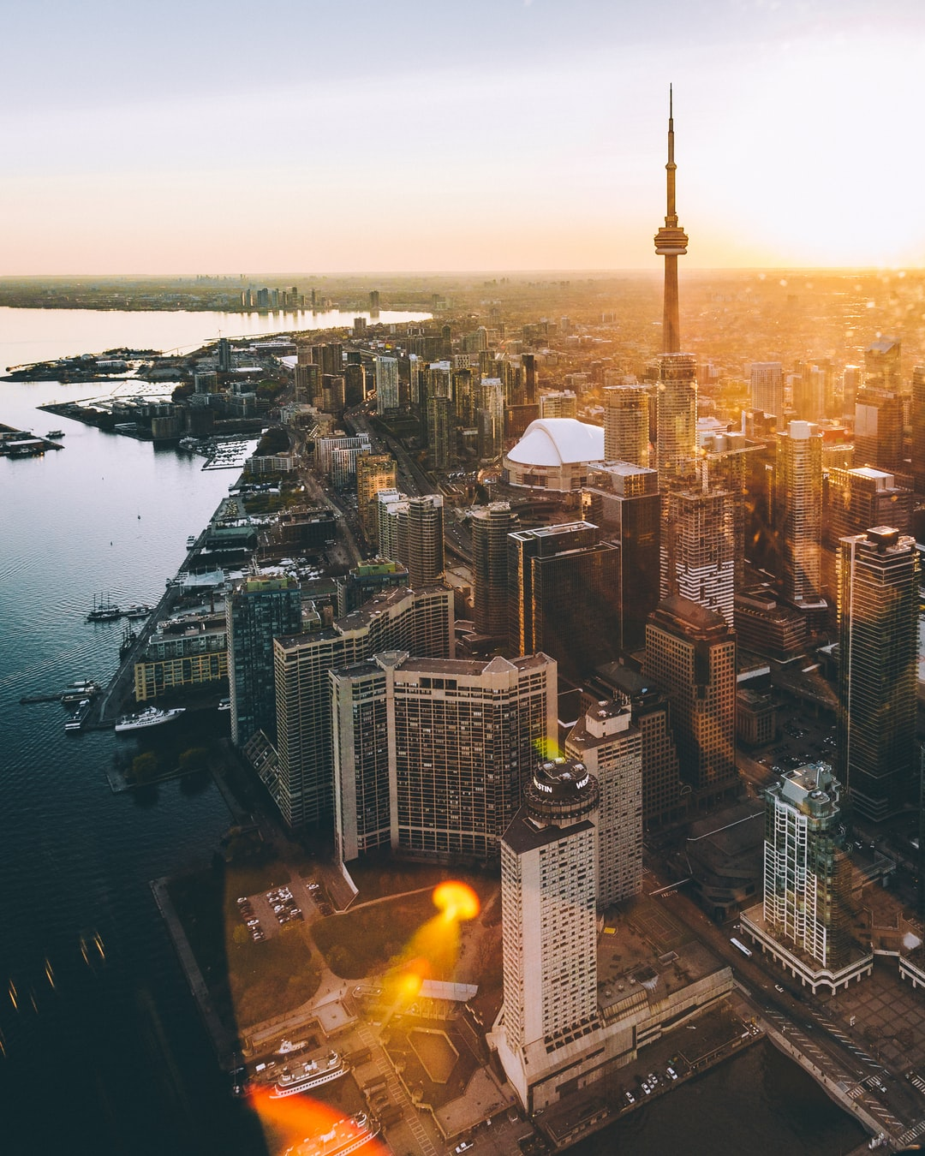
Reference list
(n.d.). Retrieved from http://www.ttc.ca/About_the_TTC/index.jsp
About us. (n.d.). Retrieved from https://www.torontohydro.com/about-us
Canada, H. (2016, August 22). Government of Canada. Retrieved from https://www.canada.ca/en/health-canada/services/canada-health-care-system.html
Canada Post. (n.d.). Find out the price of stamps: Personal. Retrieved from https://www.canadapost.ca/cpc/en/personal/sending/letters-mail/postage-rates.page

Slide 13
Reference list
City of Toronto. (2019, May 22). Fire Services. Retrieved from https://www.toronto.ca/city-government/accountability-operations-customer-service/city-administration/staff-directory-divisions-and-customer-service/fire-services/
City of Toronto. (2019, March 28). Solid Waste Management Services. Retrieved from https://www.toronto.ca/city-government/accountability-operations-customer-service/city-administration/staff-directory-divisions-and-customer-service/solid-waste-management-services/
OHIP(n.d.). Retrieved from https://www.ontario.ca/page/what-ohip-covers

